Slide 1
Fugitive Monitoring System using Ankle Bracelets
Hackathon 4.0

Slide 2
Problem Statement

Slide 3
In the present day scenario of the ever increasing criminal activities in India, there exists a very major issue in the area of Parole bailing process of the prisoners. The prisoners who are on parole aren’t allowed to cross a particular defined boundary illegally. And due to this situation in India, it is quite difficult to track and catch hold of such prisoners who violate this law. This can result in serious crimes by such fugitives. It is important that we come with a proper solution to this issue.

Slide 4
Proposed Solution

Slide 5
Due to the mentioned problem, we have come with a system of fugitive monitoring using ankle bracelets. With the help of this system, we are able to track such prisoners who violate the rule of staying within the specified boundaries. We have proposed to tie anklets loaded with tracking sensors around the ankles of all the prisoners who are on Parole. This way, such fugitives can easily be tracked and stopped by being electrocuted by the anklets.

Slide 6
Methodology

Slide 7
The prisoners are supposed to wear the anklets all the time when they are on parole. With the help of the sensors attached in the anklets, their live location will be tracked using GPS (As the project is still in its prototyping stage, we are currently using a mobile phone for gathering the location data).
The police stations, on the other hand are supposed to keep an updated app through which they’ll be notified about the prisoner’s unusual activity and take action against him according to the situation.

Slide 8
There are three main conditions on the basis of which the nearby police station ( dealing with the case) will be notified about the unusual activity and thus the person will be caught:-
If the prisoner tries to cross the specified boundary, the police will be notified about his location and strict action will be taken.
If the prisoner tries to remove the anklet he is wearing, he/she will electrocuted through the anklet and the police will be notified about his action.
If the prisoner’s mobile containing the “Tracker” app gets discharged to 20% battery power, he/she will be notified to remind him/her to charge it instantly but if it gets discharged to 10% battery power, the police will be notified about his location and action will be taken.

Slide 9
Screenshots and Code Snippets

Slide 10
WebApp Features Admin registers the authorized police stations where the distribution of bands takes place. The registered individuals can login and track the fugitives and can also assign bands to new fugitives. Technologies Used AWS RDS Python Flask HTML CSS JavaScript Jquery Flask Maps API

Slide 11
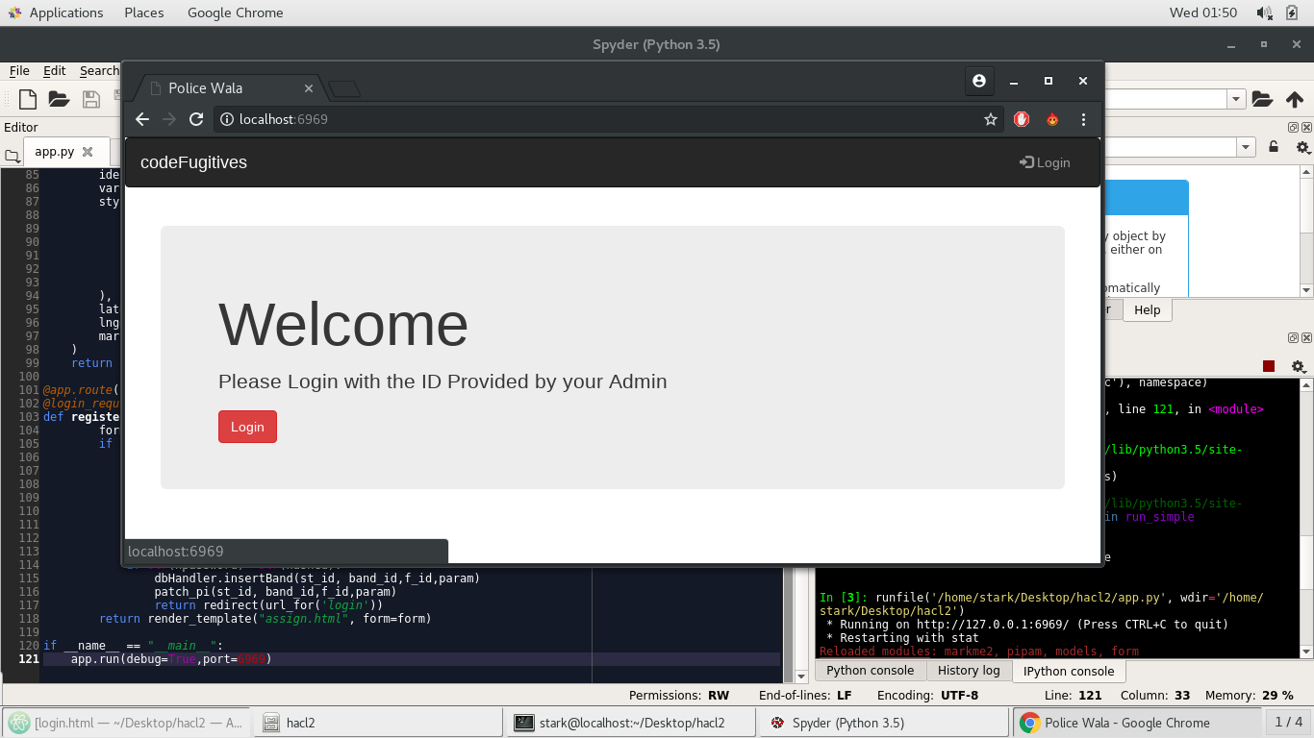

Slide 12
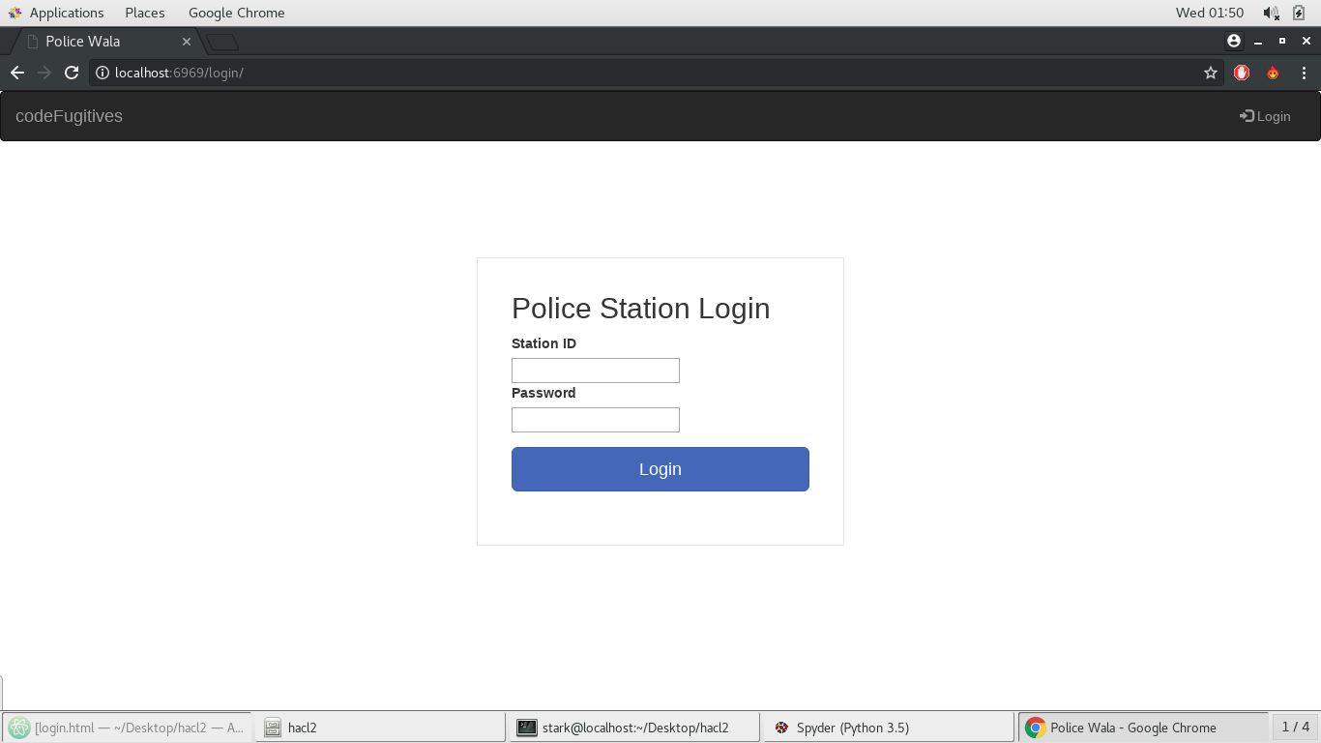

Slide 13
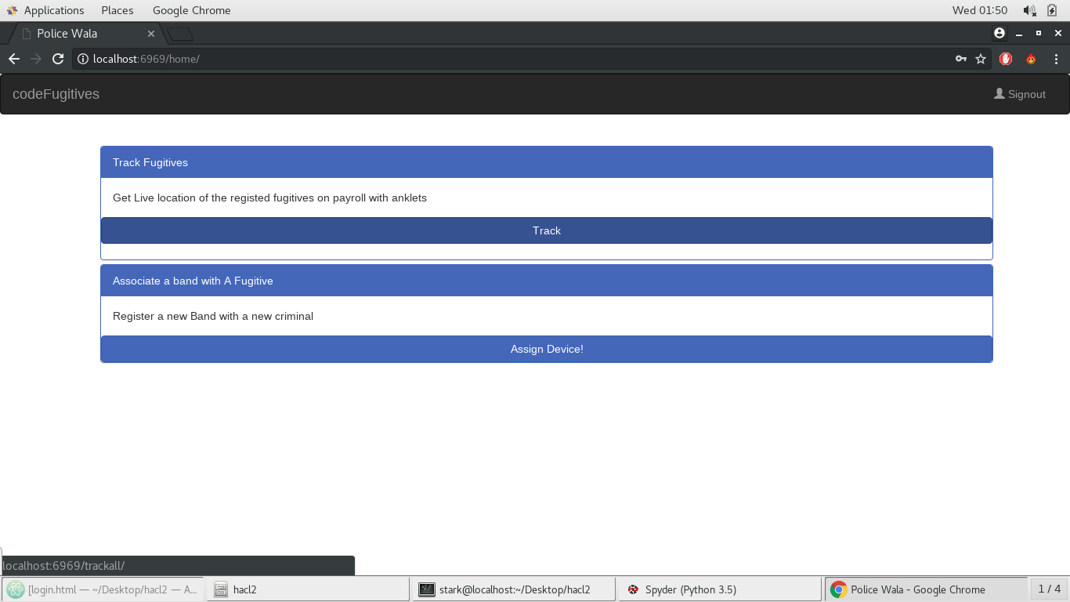

Slide 14
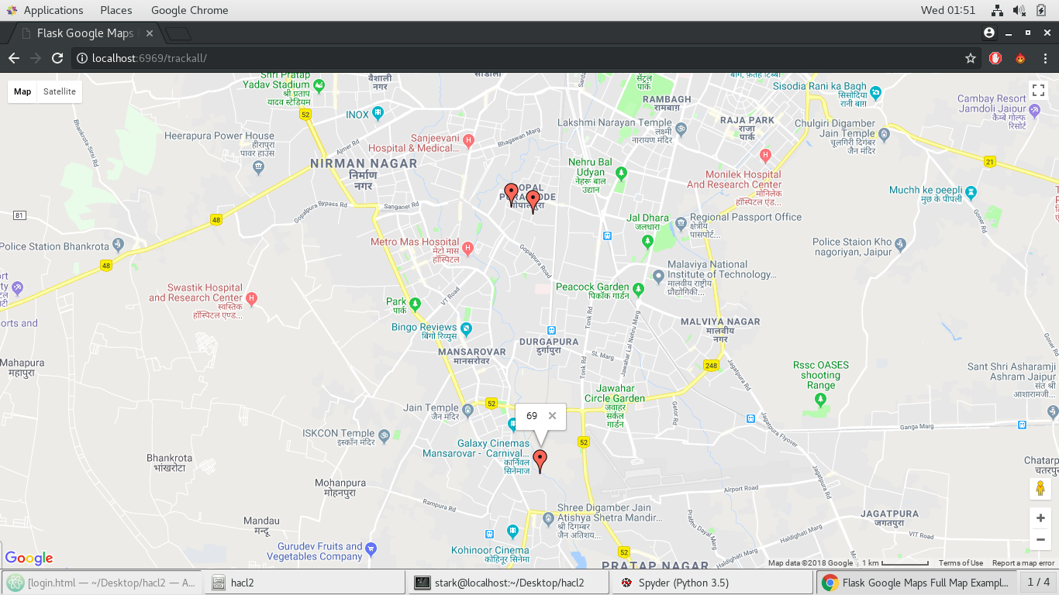

Slide 15
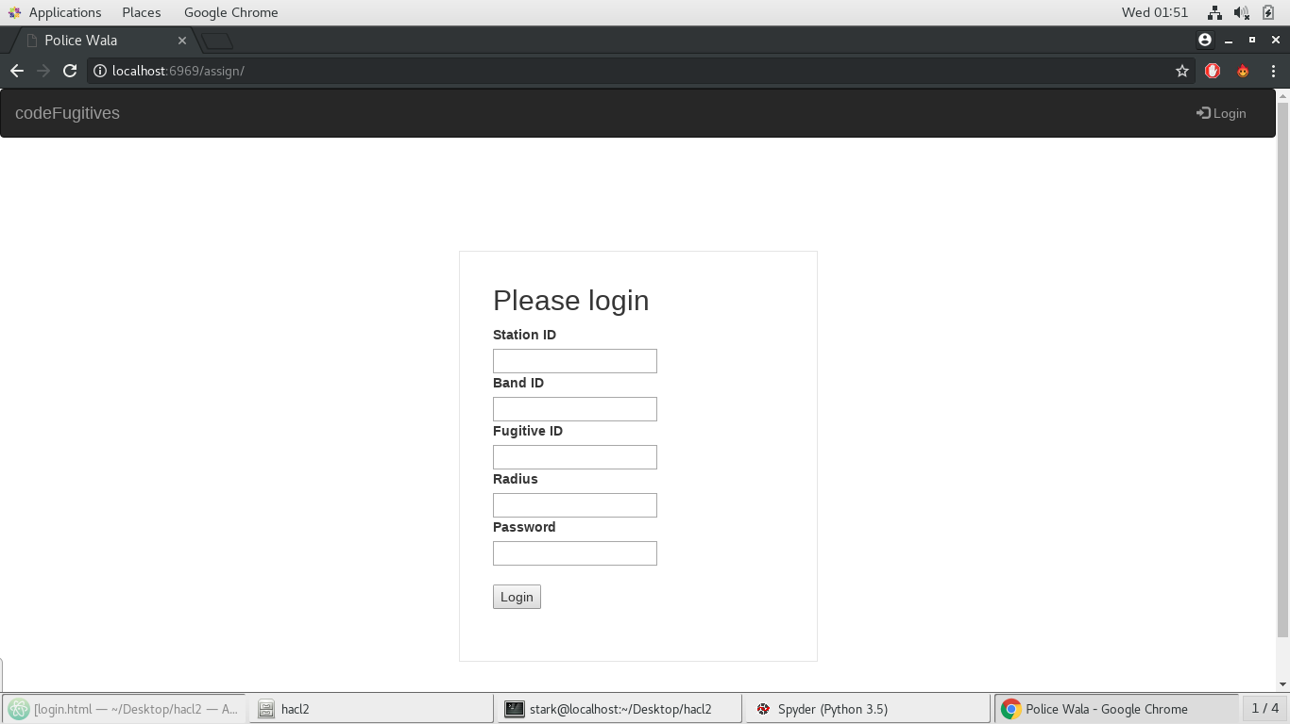

Slide 16
Mobile App Features The registered individuals can login and track the fugitives and can track the location of the fugitives during live time. In case the fugitives leave the assigned perimeter, the station is alerted Technologies Used AWS RDS Java GPS Google Maps API Firebase Push Notification Service

Slide 17
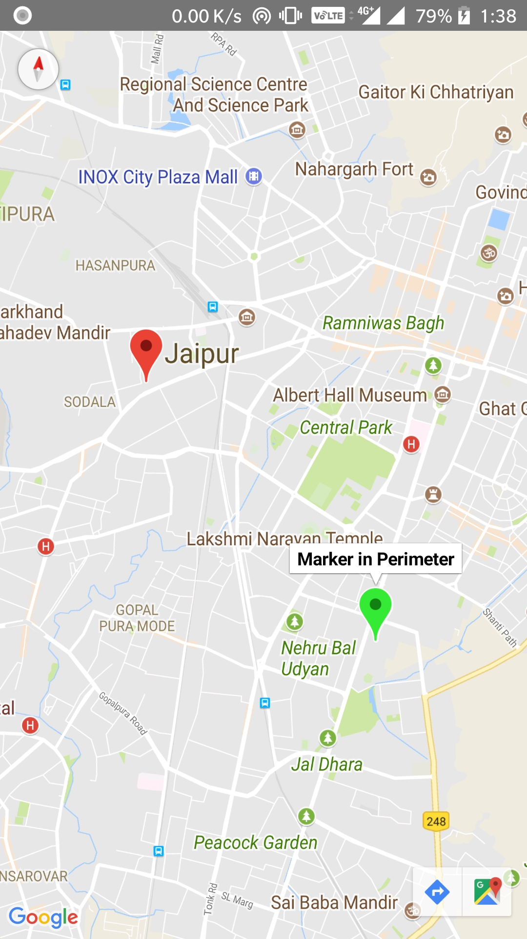

Slide 18
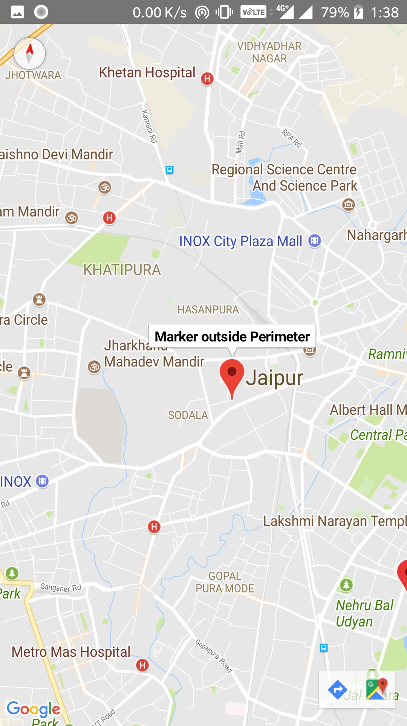

Slide 19
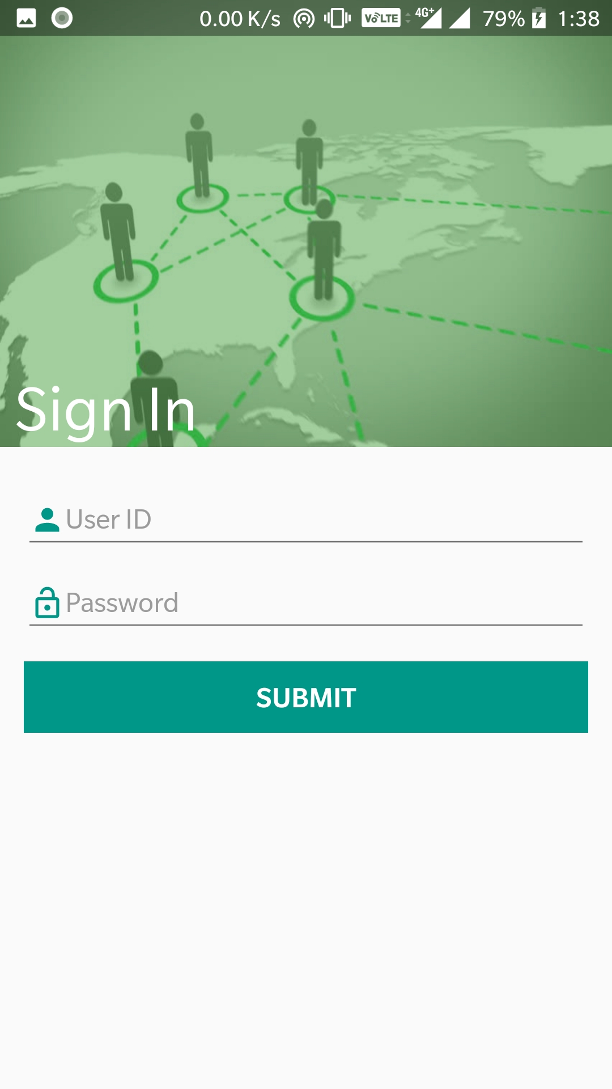

Slide 20
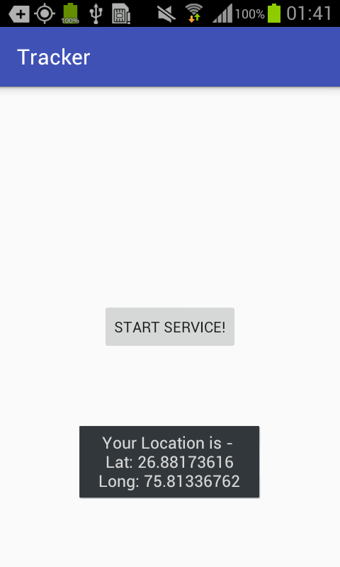

Slide 21
Why both Mobile and Web Apps?
Portability as WebApp can’t be accessed on the go.
WebApp is an inhouse solution which is easy to be operated by a layman.
Mobile App has the advantage of getting the directions to track the targeted fugitive.

Slide 22
Prototype

Slide 23
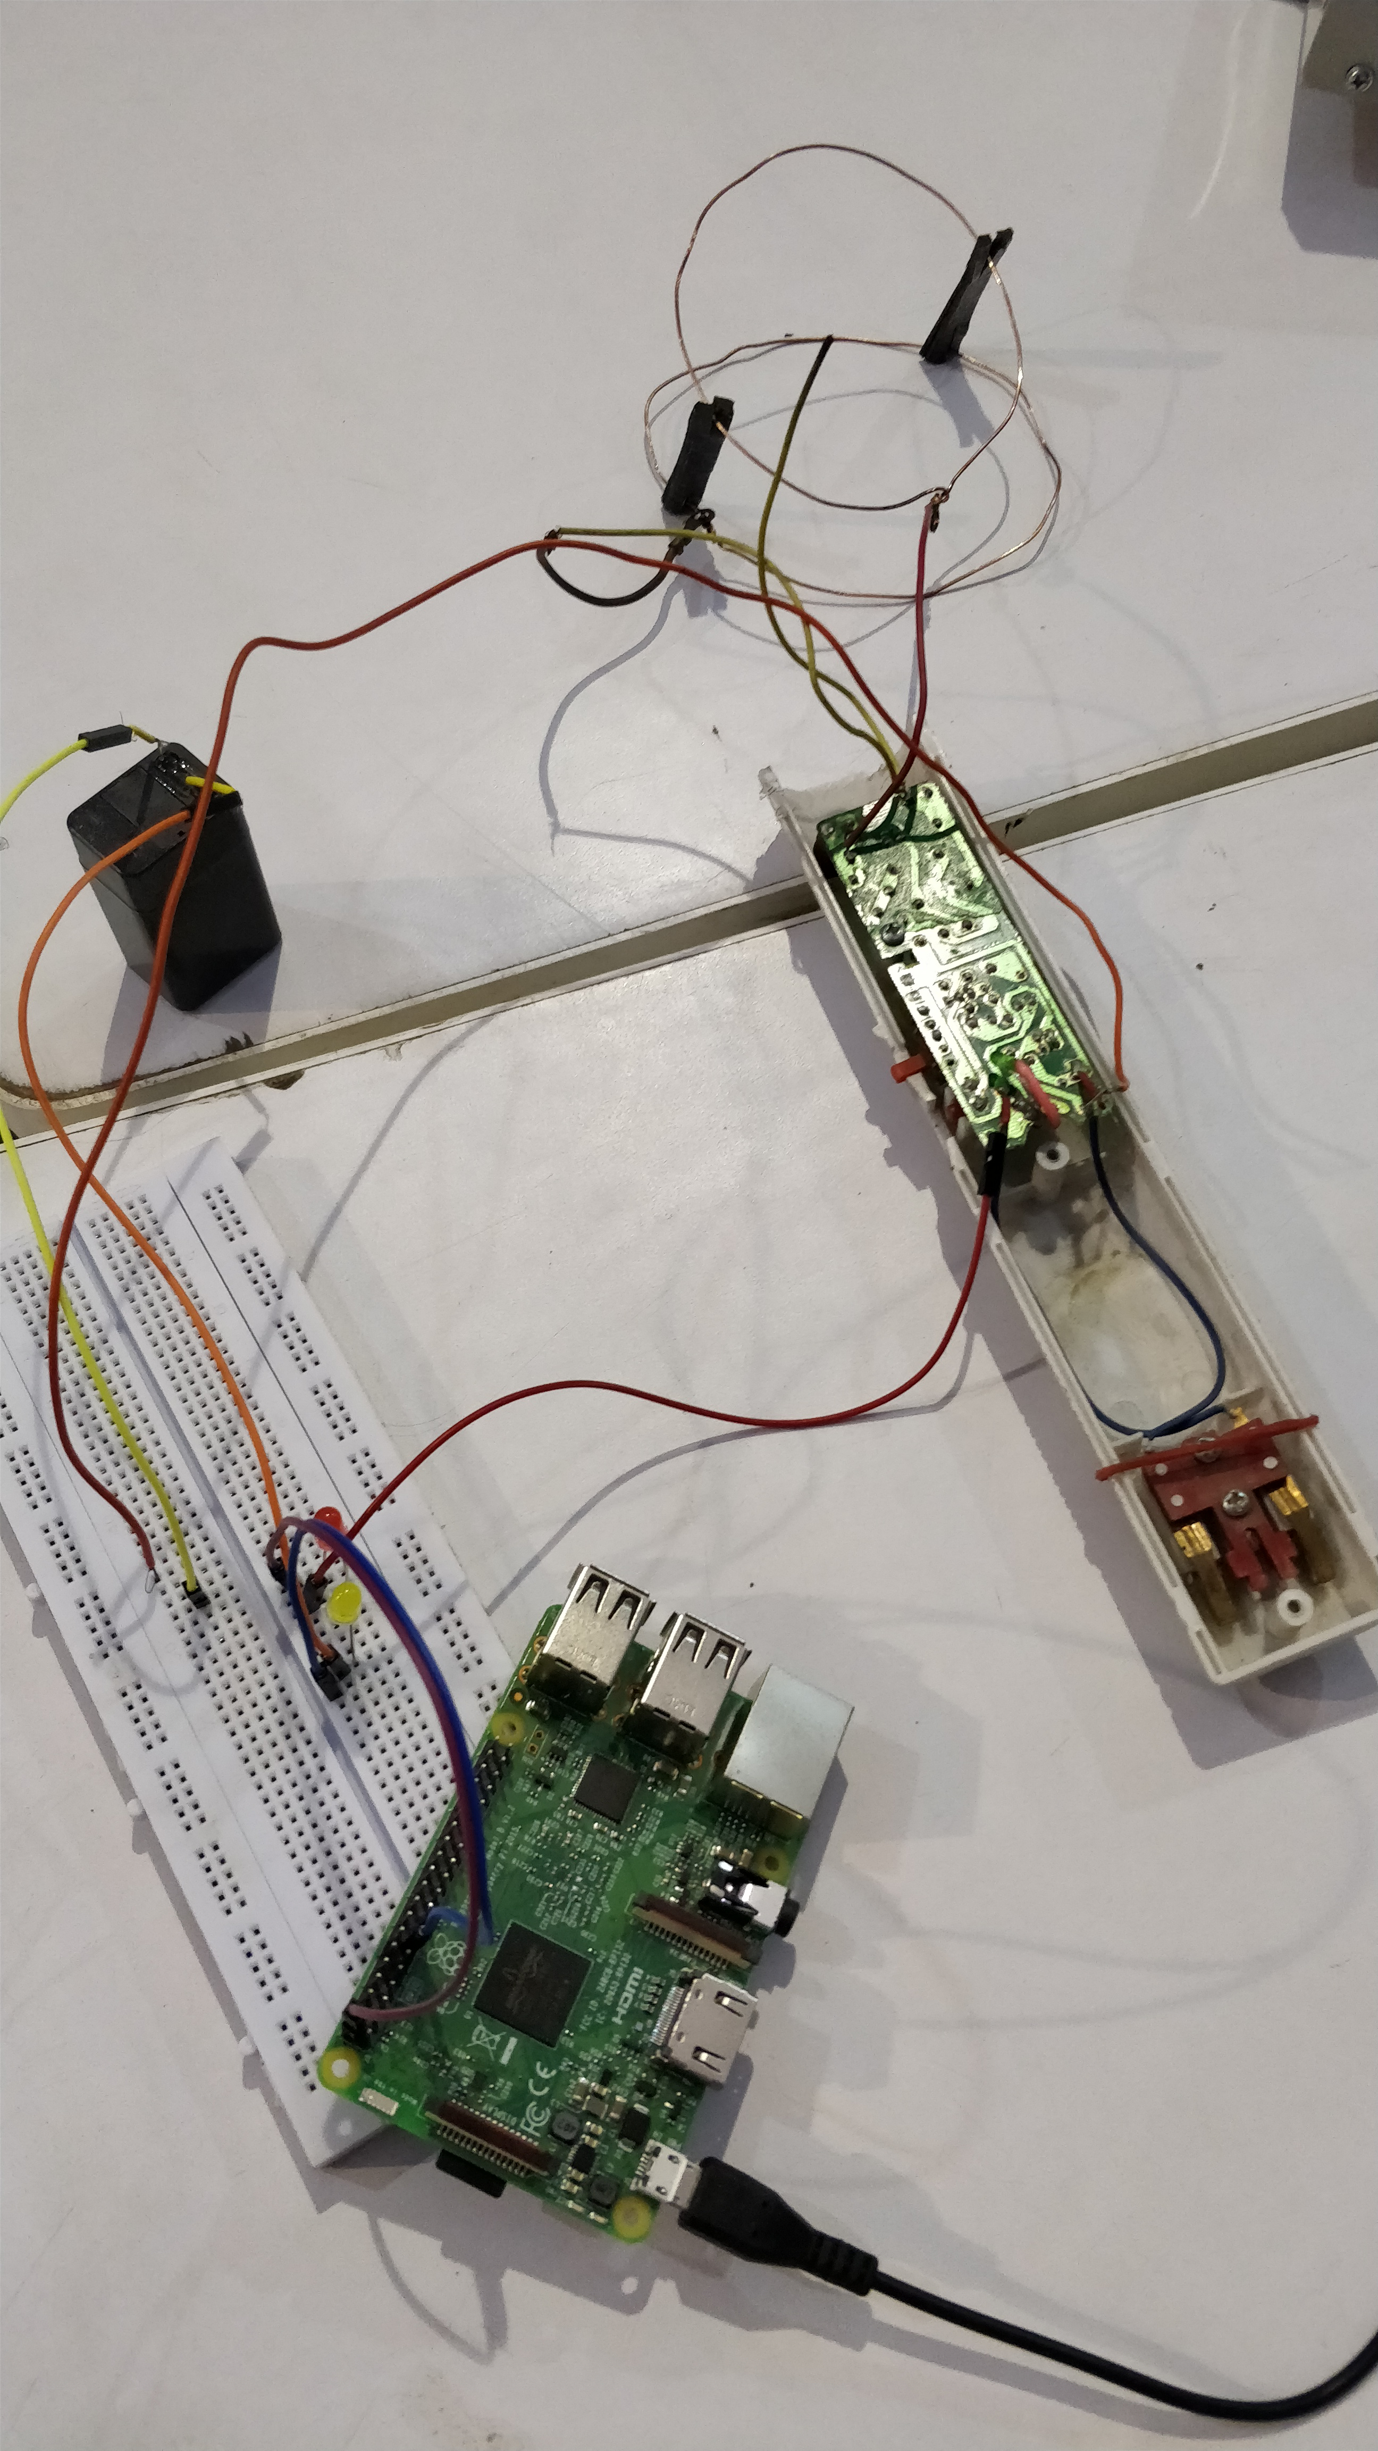
Here is the initial design of our prototype which uses a charged capacitor, a raspberry pi, some copper coils and a chargeable battery which can be used to deliver mild electric shocks in case the circuit is tampered with.

Slide 24
Conclusion

Slide 25
By using above methodology, we are able to solve this problem to quite an extent. In the near future we will definitely be extending our project by including proper GPS module and by improving the accuracy and connectivity of the system. This will be a big step forward in the betterment of our country and especially in making Jaipur a smarter city.

Slide 26
codeFugitives

Slide 27
TEAM
Members
Ayush Sharma (Team Leader)
Harsh Balot
Celina Atwasia
Arunima Mishra
Details
9649600556; ayushstarksharma@gmail.com
7568111444; harsh.raj.balot@gmail.com
9462815106; celina.atwasia@gmail.com
7073843457; arunima1496@gmail.com

Slide 28

Contact Us :
codeFugitives
9649600556 (M)
ayushstarksharma@gmail.com

Slide 29
THANK YOU!

